Slide 1


Inclusive by Design: The Person-Centred Approach to Digital Delivery at BOB ICB
Nadia Kuftinoff, Senior Digital Delivery Lead, BOB ICB
Nadia.Kuftinoff1@nhs.net

Slide 2



Slide 3
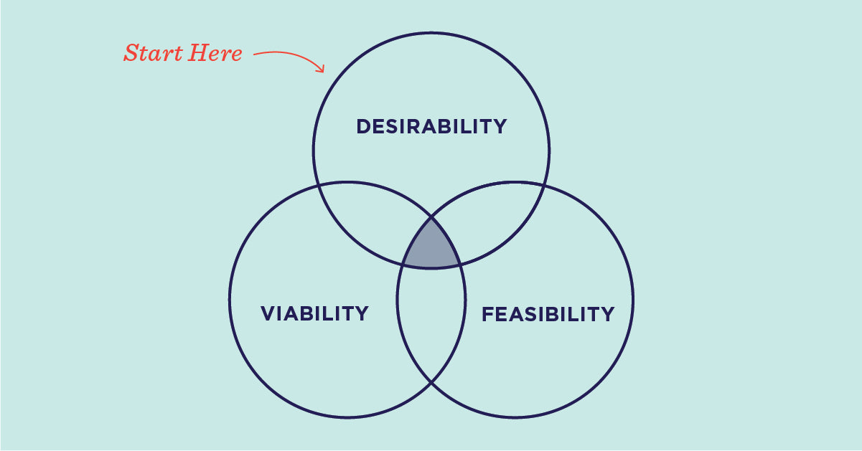

What is Design Thinking?
Ideo, Design Thinking Defined

Slide 4
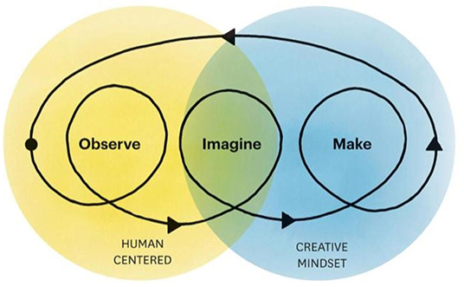


All you need is a creative mindset and empathy
Abookire, A. et al, Health Design Thinking: An Innovative Approach in Public Health to Defining Problems and Finding Solutions Ku, B. and Lupton, E. Health Design Thinking

Slide 5


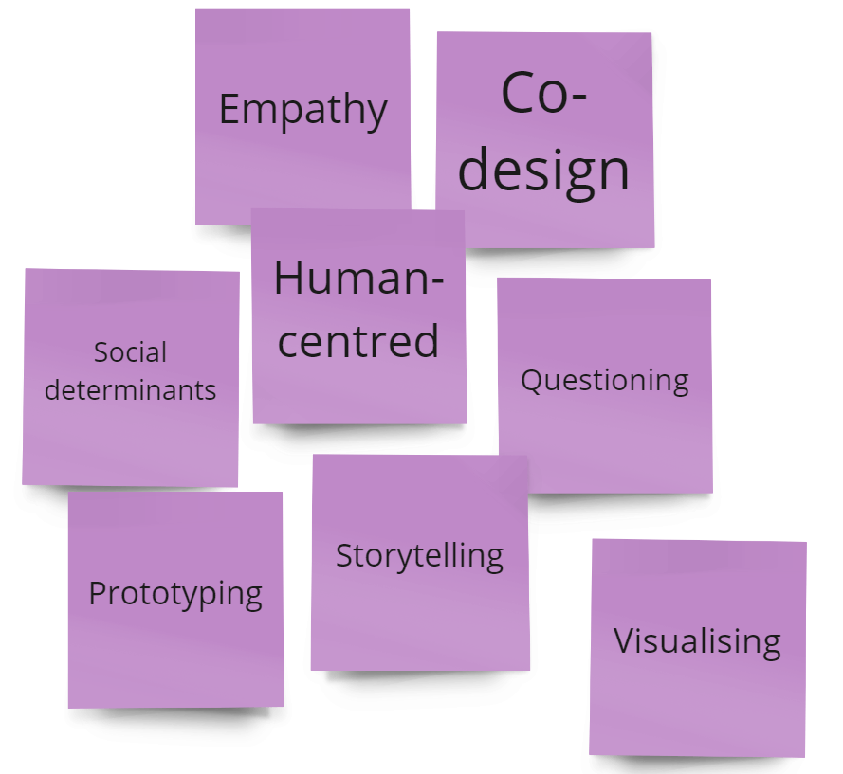
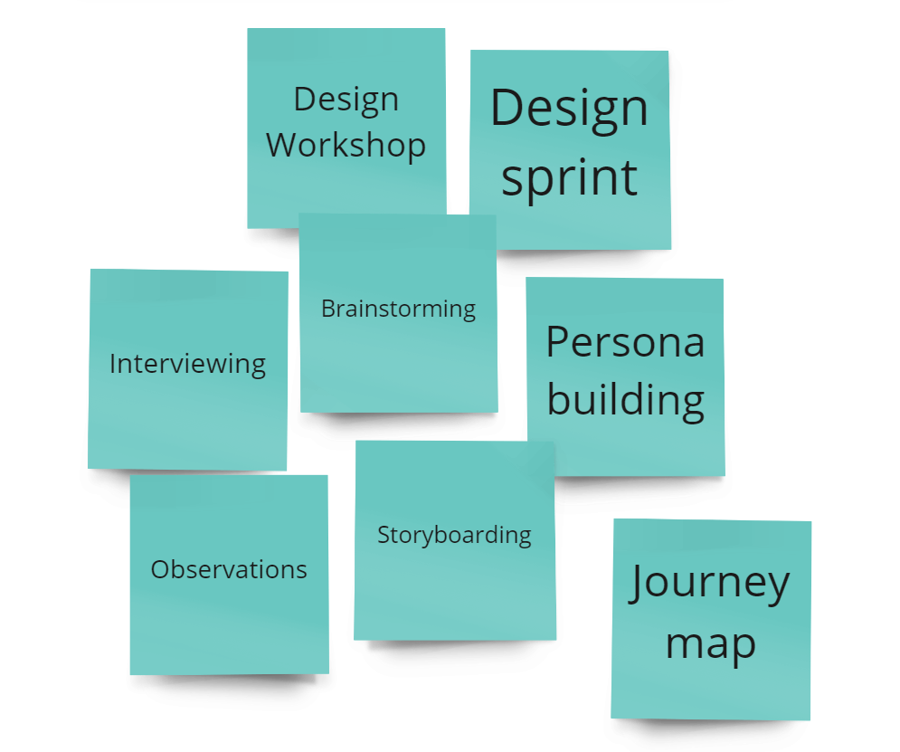
Ku, B. and Lupton, E. Health Design Thinking (2nd Edition)

Slide 6

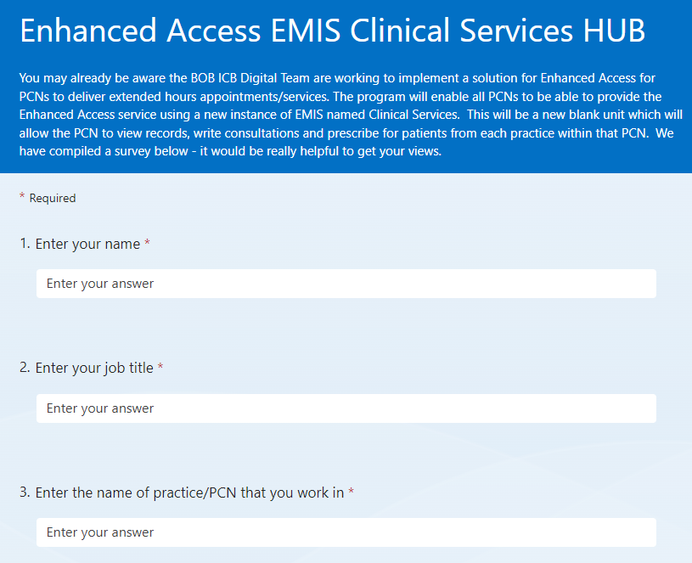
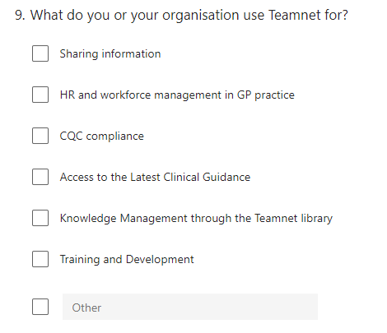
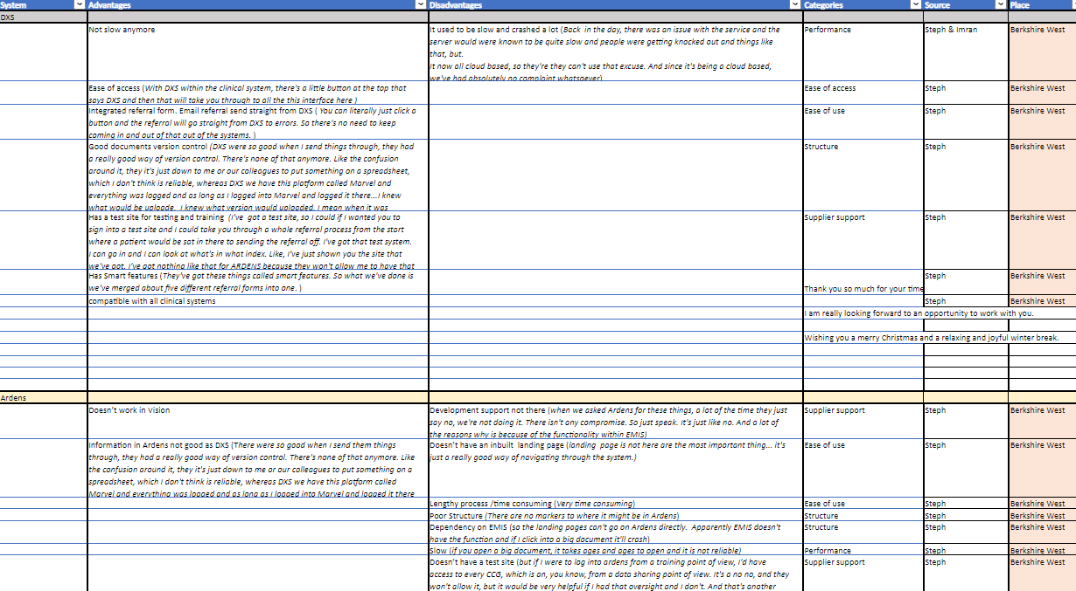
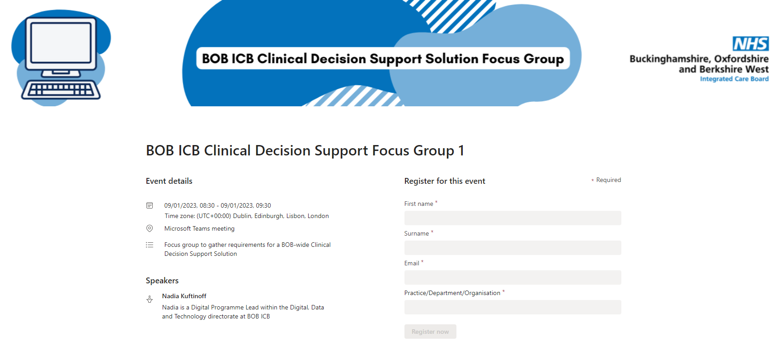
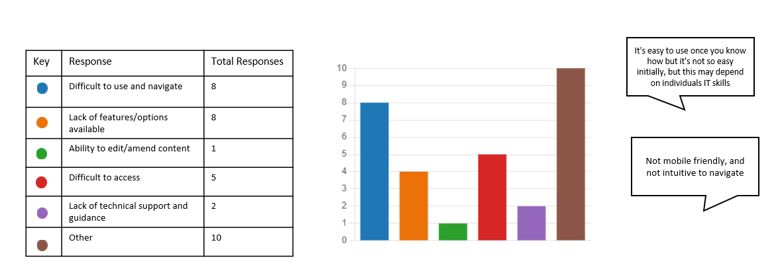
Surveys
Site Visits
Focus Groups & Interviews
Data Analysis &
Visualisation

Slide 7


Slide 8




Why Conduct User Experience Research?
Learn what end users of a system or product need and want, then employ those insights to enhance the design process for products, services or software
Rosencrance, L. What is UX Research?

Slide 9


